Slide 1

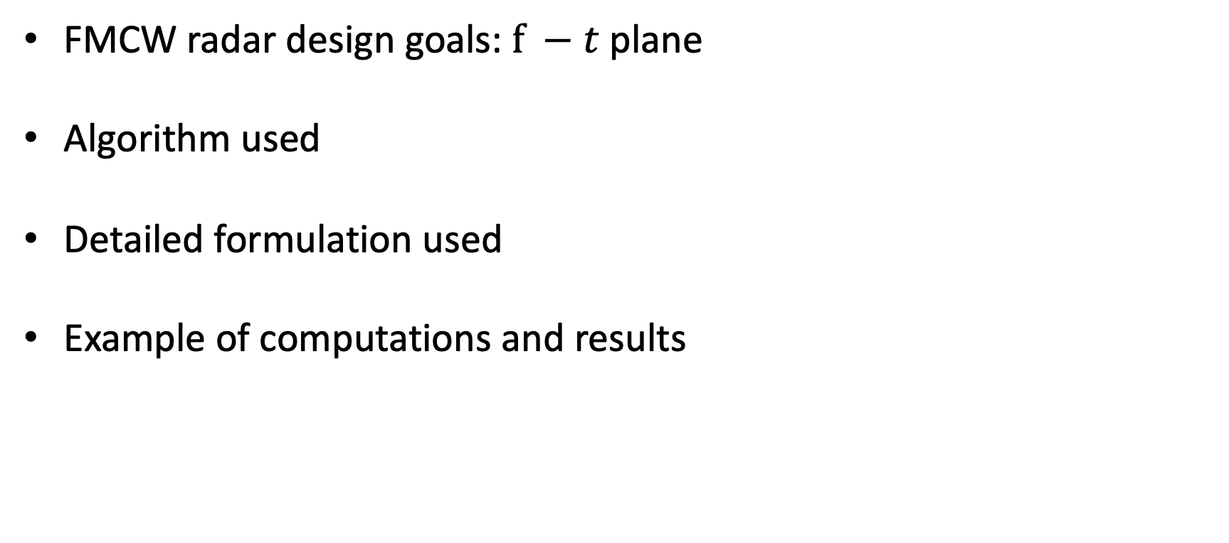
Contents
FMCW radar design goals:$f −t$ plane
Algorithm used
Detailed formulation used
Example of computations and results

Slide 2
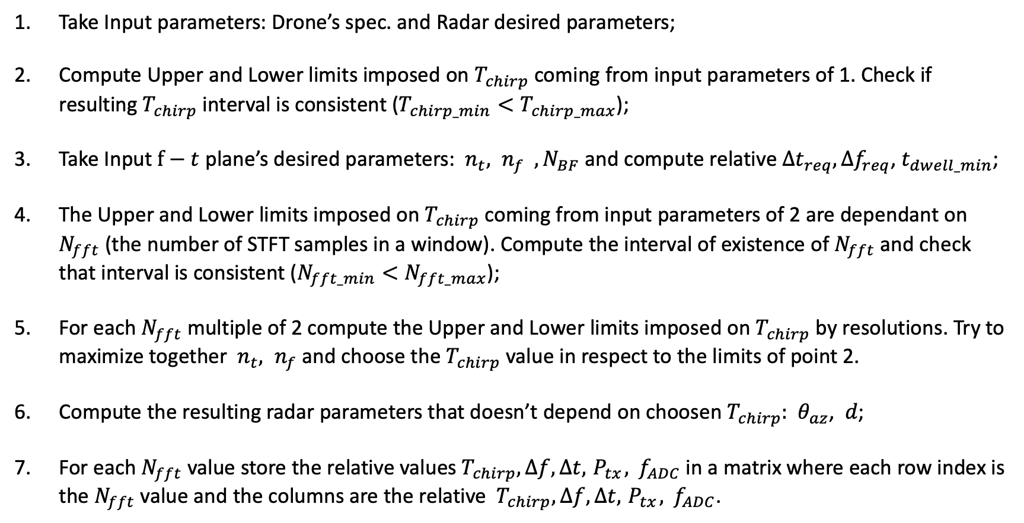
Algorithm: $f−t$ plane
Take Input parameters: Drone’s spec. and Radar desired parameters;
Compute Upper and Lower limits imposed on $T_{chirp}$ coming from input parameters of 1. Check if resulting $T_{chirp}$ interval is consistent ($T_{chirp_min}<T_{chirp_max}$);
Take Input $f−t$ plane’s desired parameters: ${ n}_{t}, n_{f} , N_{BF}$ and compute relative ${Δt}_{req},{Δf}_{req}$, $t_{dwell_min}$;
The Upper and Lower limits imposed on $T_{chirp}$ coming from input parameters of 2 are dependant on $N_{fft}$ (the number of STFT samples in a window). Compute the interval of existence of $N_{fft}$ and check that interval is consistent ($N_{fft_min}<N_{fft_max}$);
For each $N_{fft}$ multiple of 2 compute the Upper and Lower limits imposed on $T_{chirp}$ by resolutions. Try to maximize together ${ n}_{t}, n_{f}$and choose the $T_{chirp}$ value in respect to the limits of point 2.
Compute the resulting radar parameters that doesn’t depend on choosen $T_{chirp}:$ ${ θ}_{az}$, $d$;
For each $N_{fft}$ value store the relative values${ T}_{chirp},Δf,Δt, { P}_{tx}, { f}_{ADC}$ in a matrix where each row index is the $N_{fft}$ value and the columns are the relative ${ T}_{chirp},Δf,Δt, { P}_{tx}, { f}_{ADC}$.

Slide 3



















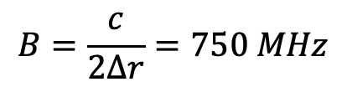

Algorithm: calculation example helic. drone
1.Input drone’s parameters
1.Input radar parameters
$$Ω=25∗2π rad/s$$
$$f=9 GHz$$
$$ρ=0.6 m$$
$$λ=0.0333 m$$
$v_{tip}=Ωρ$ $=$ $94.25 m/s$
$$N_{r}=1$$
$$∆r=0.2 m$$
$$N_{b}=2$$
$$B=\frac{c}{2∆r}=750 MHz$$
$T_{BF}=\frac{2π}{N_{b}Ω}s$ = $20 ms$
$t_{renew}=2 s$
$f_{max}=\frac{2v_{tip}}{λ}=5660Hz$
$$SNR=20 dB$$
$$θ_{el}=60°$$
$$σ=0.03 m^{2}$$
$$T_{s}=290 K$$
$$σ_{body}=0.25 σ$$
$$F=10 dB$$
$$σ_{blade}=0.75 σ$$
$$R_{max}=1000 m$$
$$f_{D_body}=0 Hz$$

Slide 4

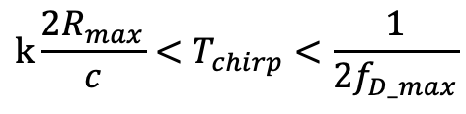








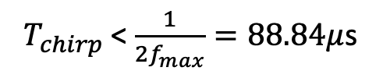

Algorithm: calculation example helic. drone
2. Compute Upper and Lower limits imposed on $T_{chirp}$ coming from input parameters:
Unambiguous velocity
${ T}_{chirp}$ < $\frac{1}{2f_{max}}=88.84μ$s
$f_{max}=5660Hz$
$${k\frac{2R_{max}}{c}<T}_{chirp}<\frac{1}{2f_{D_max}}$$
$$R_{max}=1000 m$$
${ T}_{chirp}$ > $k\frac{2R_{max}}{c}=66.7μ\text{s}$
Unambiguous range
${ T}_{chirp_min}$
${ T}_{chirp_max}$
With K=10
3. Take Input $f−t$ plane’s parameters:
${ n}_{t}=n_{f}=N_{BF}=5$
${Δt}_{req}$ = $\frac{T_{BF}}{{ n}_{t}}=4 ms$
${ n}_{t}:$ n. of desired time-pixel between two Blade Flash
${ n}_{f}:$ n. of desired freqeuncy-pixel inside a Blade Flash
${Δf}_{req}$ = $\frac{f_{max}}{{ n}_{f}}=1132 Hz$
$N_{BF}:$ n. of desired Blade Flash on f-t plane
${ t}_{dwell_min}$ = $N_{BF}T_{BF}$= $0.1s$

Slide 5
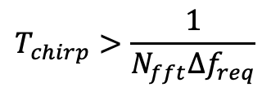
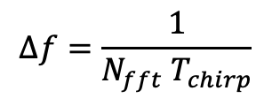
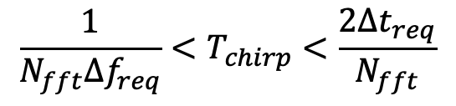
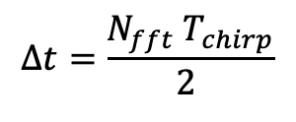


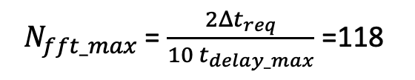


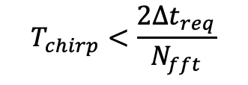
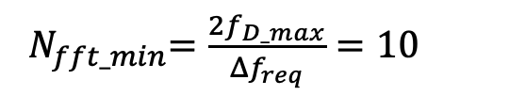
Algorithm: calculation example helic. drone
4. The Upper and Lower limits imposed on $T_{chirp}$ coming from resolutions of STFT
$Δt<$ ${Δt}_{req}$
$$Δt=\frac{N_{fft}{ T}_{chirp}}{2 }$$
$$T_{chirp}>\frac{1}{N_{fft}{Δf}_{req}}$$
$${\frac{1}{N_{fft}{Δf}_{req}}<T}_{chirp}<\frac{2{Δt}_{req}}{N_{fft}}$$
$Δf<$ ${Δf}_{req}$
$$Δf=\frac{1}{N_{fft}{ T}_{chirp}}$$
$$T_{chirp}<\frac{2{Δt}_{req}}{N_{fft}}$$
$$T_{chirp_min⁡_res}$$
$$T_{chirp_max⁡_res}$$
5. Compute interval of existence of $N_{fft}$ ( values of N compatible with limits of 2.)
${ N}_{fft_min}=\frac{2f_{D_max}}{{Δf}_{req}}=10$
${ N}_{fft_max}$ = $\frac{2{Δt}_{req}}{10 t_{delay_max}}$ =118

Slide 6

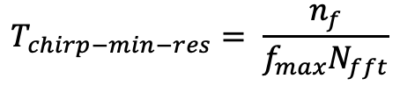

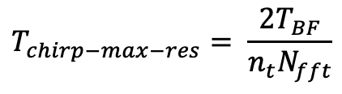
Algorithm: calculation example helic. drone
5. For each $N_{fft}$fix $T_{chirp}$maximizing $n_{f }and{ n}_{t}$:
1.Try to increment $n_{f}$ and $n_{t}$ by 1 at each cycle
2.Recompute
$$T_{chirp−max−res}= \frac{2T_{BF}}{n_{t}N_{fft}}$$
$$T_{chirp−min−res}= \frac{n_{f}}{f_{max}N_{fft}}$$
and
3.Check if that interval is consistent:
Yes: repeat from 1.
No: stop cycle.
4.Choose the max chirp value of precedent $n_{f}$ and $n_{t}$
4.1 I$f T_{chirp−max−res}$ is higher than $T_{chirp−max−radar}$ choose it
4.2 I$f T_{chirp−max−res}$ is lower than $T_{chirp−min−radar}$ choose it
6. Compute: ${ θ}_{az}$, $d$; (depend on dwell time and renewal time)
7. Compute: $Δf,Δt, { P}_{tx}, { f}_{ADC}$ (depend on chirp duration chosen)

Slide 7
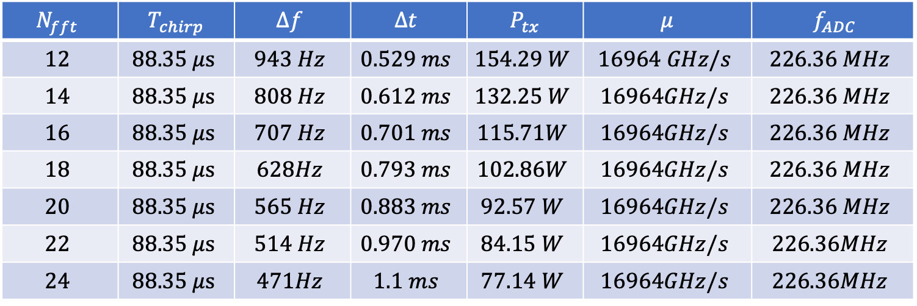




Result: calculation example helic. drone
For generic helicopter drone:
$$N_{fft}$$ | $${ T}_{chirp}$$ | $$Δf$$ | $$Δt$$ | $${ P}_{tx}$$ | $$μ$$ | $${ f}_{ADC}$$
$$12$$ | $$88.35 μs$$ | $$943 Hz$$ | $$0.529 ms$$ | $$154.29 W$$ | $$16964 GHz/s$$ | $$226.36 MHz$$
$$14$$ | $$88.35 μs$$ | $$808 Hz$$ | $$0.612 ms$$ | $$132.25 W$$ | $$16964GHz/s$$ | $$226.36 MHz$$
$$16$$ | $$88.35 μs$$ | $$707 Hz$$ | $$0.701 ms$$ | $$115.71W$$ | $$16964GHz/s$$ | $$226.36 MHz$$
$$18$$ | $$88.35 μs$$ | $$628Hz$$ | $$0.793 ms$$ | $$102.86W$$ | $$16964GHz/s$$ | $$226.36 MHz$$
$$20$$ | $$88.35 μs$$ | $$565 Hz$$ | $$0.883 ms$$ | $$92.57 W$$ | $$16964GHz/s$$ | $$226.36 MHz$$
$$22$$ | $$88.35 μs$$ | $$514 Hz$$ | $$0.970 ms$$ | $$84.15 W$$ | $$16964GHz/s$$ | $$226.36MHz$$
$$24$$ | $$88.35 μs$$ | $$471Hz$$ | $$1.1 ms$$ | $$77.14 W$$ | $$16964GHz/s$$ | $$226.36MHz$$
$$B=750MHz$$
$N_{BF}=5$
${ t}_{dwell_min}$ = $0.1s$
$$θ_{az}=18 °$$
d = 0.12m

Slide 8
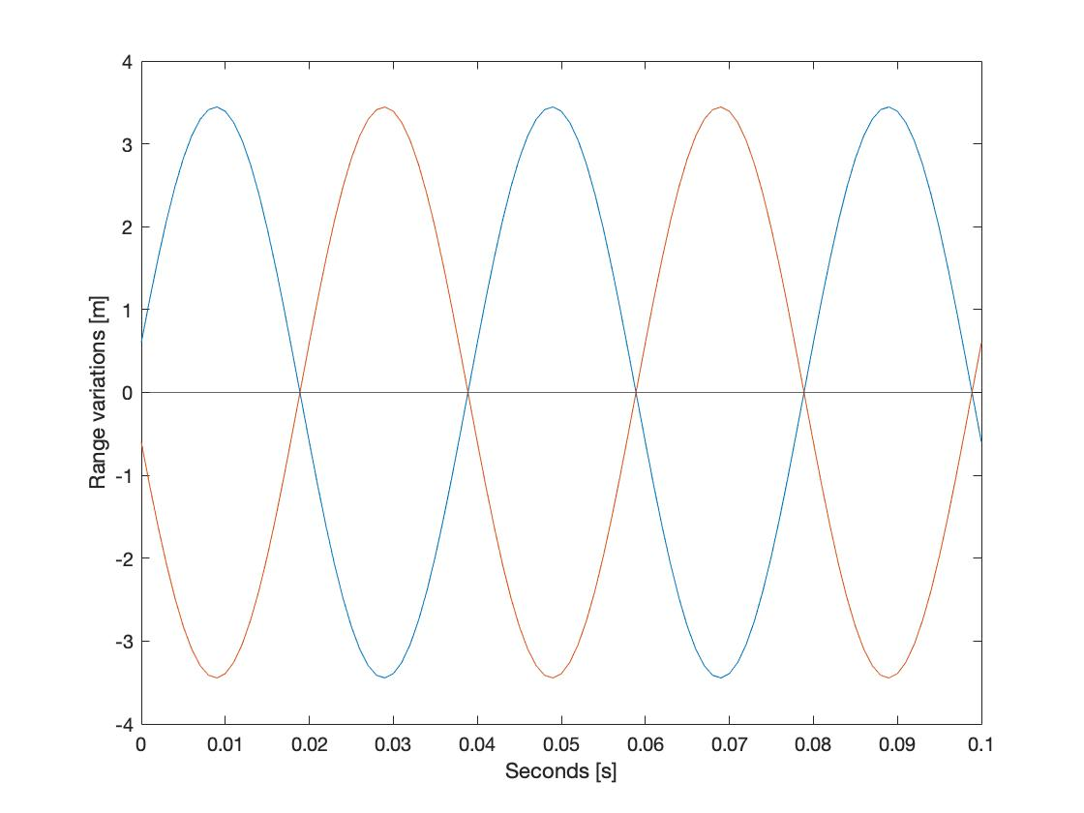



$$N_{b}=2$$
$$R_{migr_max}$$
$$T_{BF}$$

Slide 9
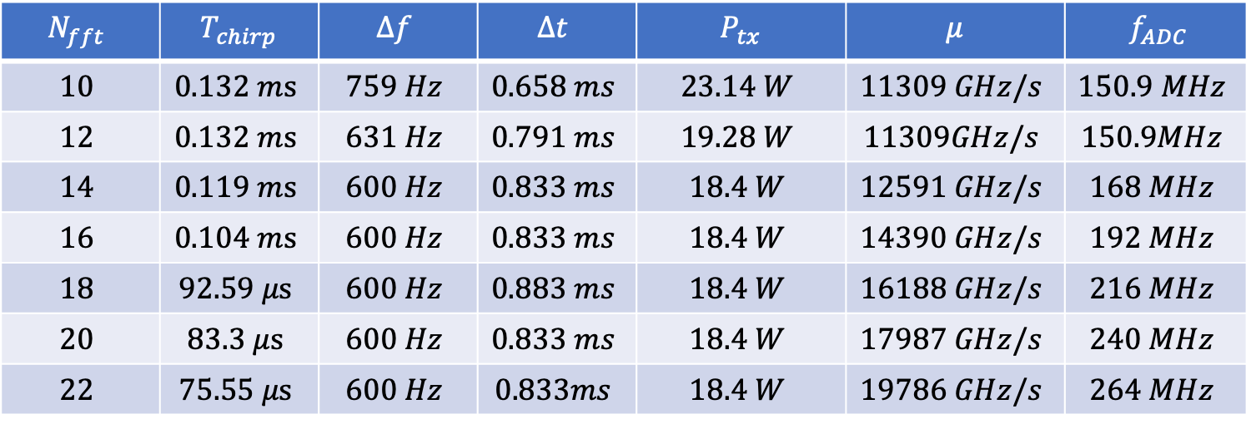



Result: calculation example quad. drone
For generic quadcopter drone:
$$B=750MHz$$
$$N_{fft}$$ | $${ T}_{chirp}$$ | $$Δf$$ | $$Δt$$ | $${ P}_{tx}$$ | $$μ$$ | $${ f}_{ADC}$$
$$10$$ | $$0.132 ms$$ | $$759 Hz$$ | $$0.658 ms$$ | $$23.14 W$$ | $$11309 GHz/s$$ | $$150.9 MHz$$
$$12$$ | $$0.132 ms$$ | $$631 Hz$$ | $$0.791 ms$$ | $$19.28 W$$ | $$11309GHz/s$$ | $$150.9MHz$$
$$14$$ | $$0.119 ms$$ | $$600 Hz$$ | $$0.833 ms$$ | $$18.4 W$$ | $$12591 GHz/s$$ | $$168 MHz$$
$$16$$ | $$0.104 ms$$ | $$600 Hz$$ | $$0.833 ms$$ | $$18.4 W$$ | $$14390 GHz/s$$ | $$192 MHz$$
$$18$$ | $$92.59 μs$$ | $$600 Hz$$ | $$0.883 ms$$ | $$18.4 W$$ | $$16188 GHz/s$$ | $$216 MHz$$
$$20$$ | $$83.3 μs$$ | $$600 Hz$$ | $$0.833 ms$$ | $$18.4 W$$ | $$17987 GHz/s$$ | $$240 MHz$$
$$22$$ | $$75.55 μs$$ | $$600 Hz$$ | $$0.833ms$$ | $$18.4 W$$ | $$19786 GHz/s$$ | $$264 MHz$$
$N_{BF}=5$
${ t}_{dwell_min}$ = $25 ms$
$$θ_{az}=4.5°$$

Slide 10







$$N_{Range Bin}$$
Chirp 1
Chirp 2
Chirp 3
$N_{FFT}$ = 3
Chirp 4
Chirp 5
Chirp 6
$$N_{chirp}$$
$$N_{page}=$$
$${N_{chirps}/N}_{FFT}$$
$$N_{Range Bin}$$
Page 2
$$N_{FFT}$$
Page 1

Slide 11

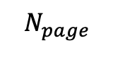
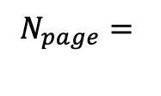



$$N_{page}=$$
$${N_{chirps}/N}_{FFT}$$
Range Bin 7
$$N_{Range Bin}$$
$$N_{FFT}$$
Page 2
Page 1
$$N_{page}$$
$$N_{FFT}$$

